Slide 1

Real-Life Data Analysis
Robert Brown, PhD
Notes:
Talk in two parts - first, some of my research in multiple sclerosis, second, short tutorial on a newish technique called compressed sensing
MS - chronic, progressive disease characterized by development of demyelinating lesions in the brain

Slide 2
All measurements are wrong.

Slide 3

Notes:
what do you see in this image? do you see a brain?

Slide 4
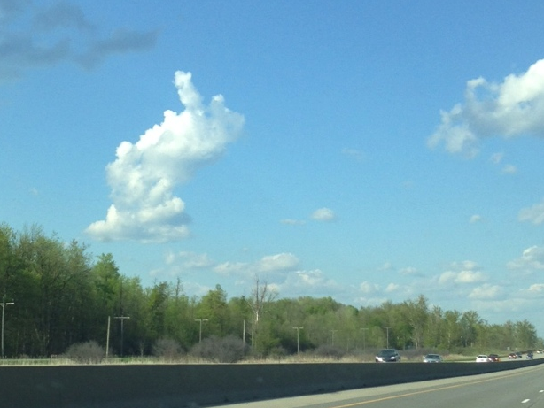
Notes:
do you see the finger?

Slide 5
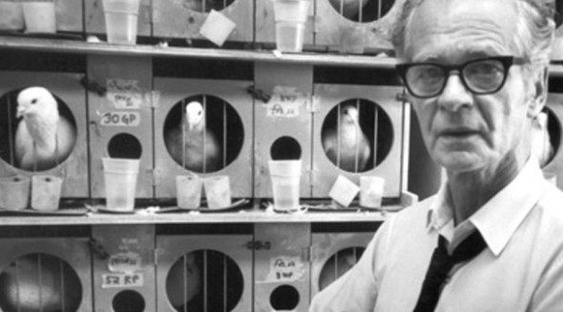
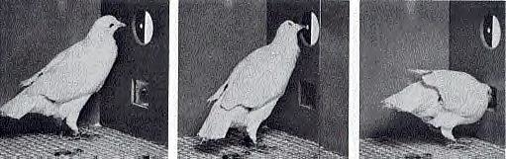
'Superstition' in the pigeon. Skinner, B. F.
Journal of Experimental Psychology, Vol 38(2), Apr 1948, 168-172
Notes:
humans are good at pattern recognition, and animals too.

Slide 6
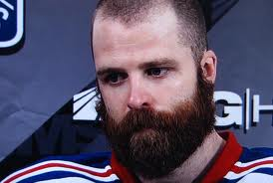
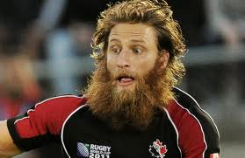
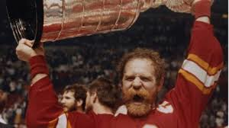
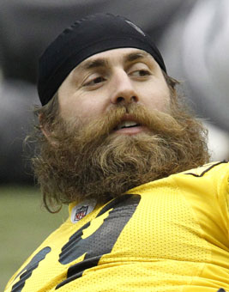
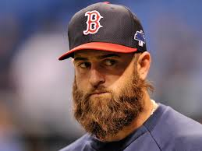

Slide 7
All measurements are wrong.
We’re bad at interpreting data
What do we do?

Slide 8
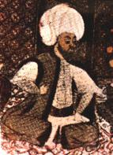
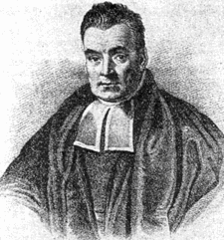
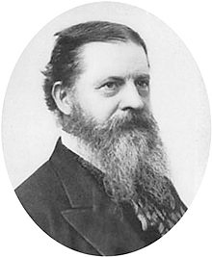
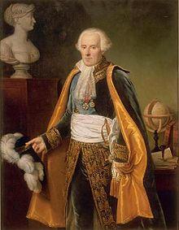
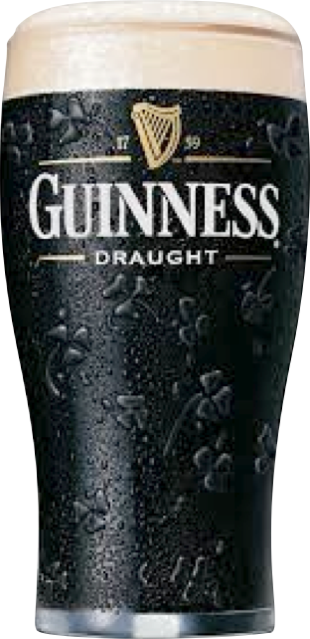
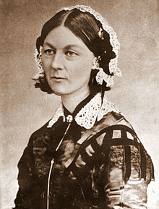
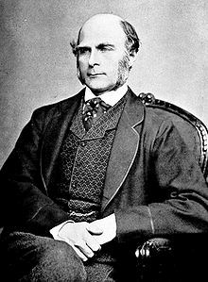
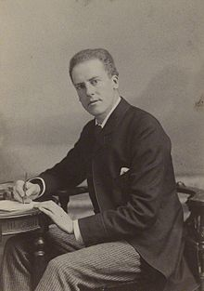
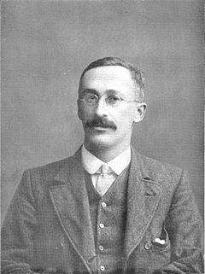
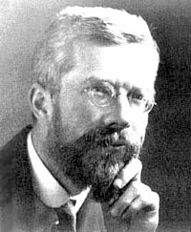
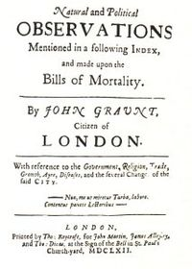
Notes:
famous statisticians throughout human history, with Florence Nightingale in the centre.

Slide 9
Mathematics is the language of the Universe.
Statistics is the dialect it speaks.

Slide 10
High precision, low accuracy
Low variance,
high bias
precision / variance
accuracy / bias

Slide 11
Low precision, high accuracy
High variance,
low bias
precision / variance
accuracy / bias

Slide 12
You’re confidently wrong
You’re tentatively correct

Slide 13
The mean converges to the wrong value.
Bias is not handled by statistics

Slide 14
The mean converges to the correct value.
Variance is handled by statistics
Improve your measurement to reduce variance, or just collect more data

Slide 15
Option 1: Better Measurement
Nate Silver’s 538

Slide 16
Predict election results using polling data

Slide 17
fivethirtyeight.com
threehundredeight.com

Slide 18
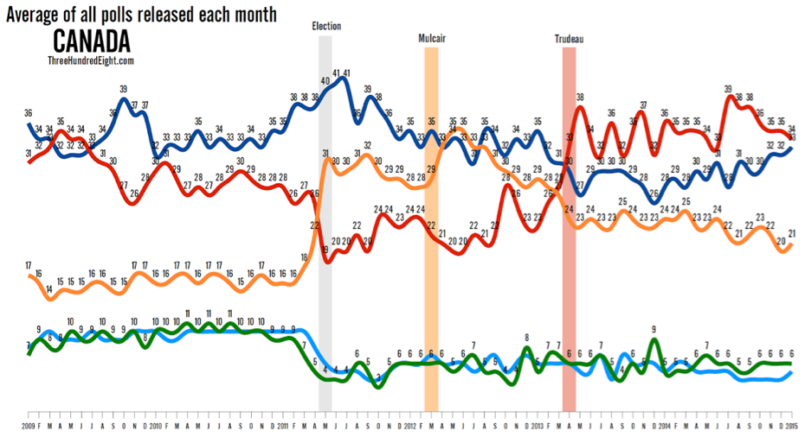

Slide 19
Local Opinion Polls
“Average”
Call Individual Elections
Overall Forecast

Slide 20
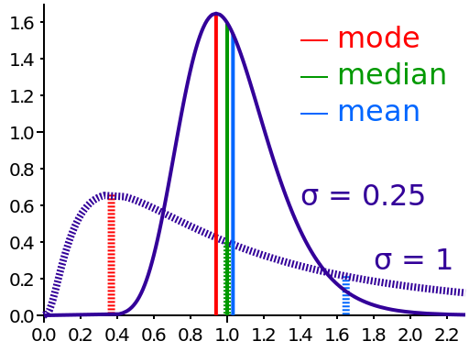

Slide 21
variance = inherent variance
        + methodological variance

Slide 22
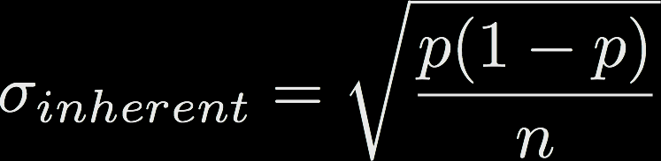


Slide 23
http://fivethirtyeight.com/features/how-fivethirtyeight-calculates-pollster-ratings/

Slide 24
http://fivethirtyeight.com/features/how-fivethirtyeight-calculates-pollster-ratings/

Slide 26
Option 2: Big Data
Google Flu Trends

Slide 27
Predict flu outbreaks using web search data

Slide 28
Lots-O-Data
(Google search queries)
Nature paper!
Correlate search volume with CDC flu data
Model queries vs. flu data
Sum top queries
Queries sorted by R²

Slide 29


- % flu-related doctor visits
- % of search queries

Slide 30
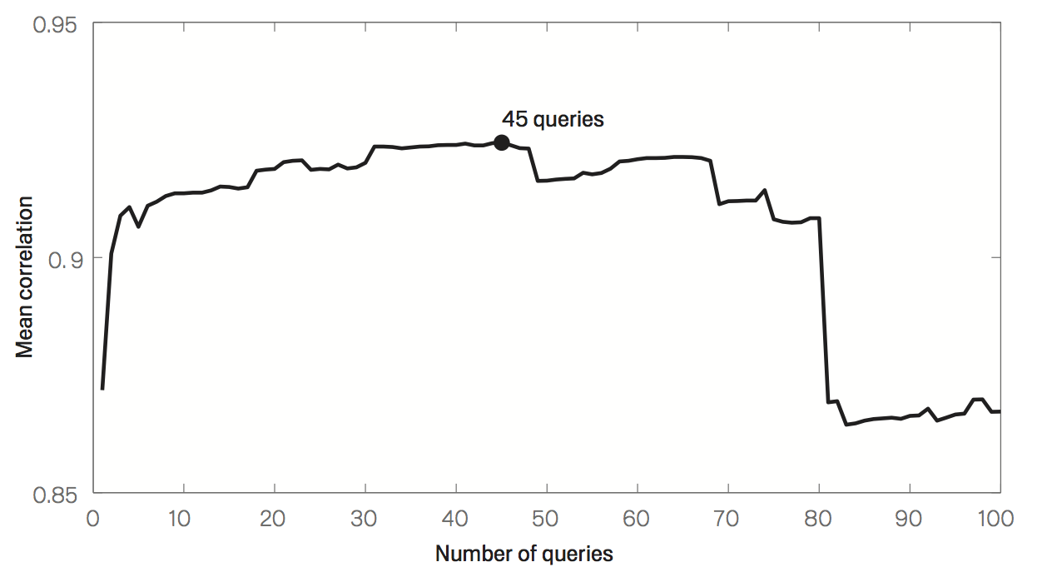
“Oscar Nominations”
https://research.google.com/archive/papers/detecting-influenza-epidemics.pdf

Slide 31
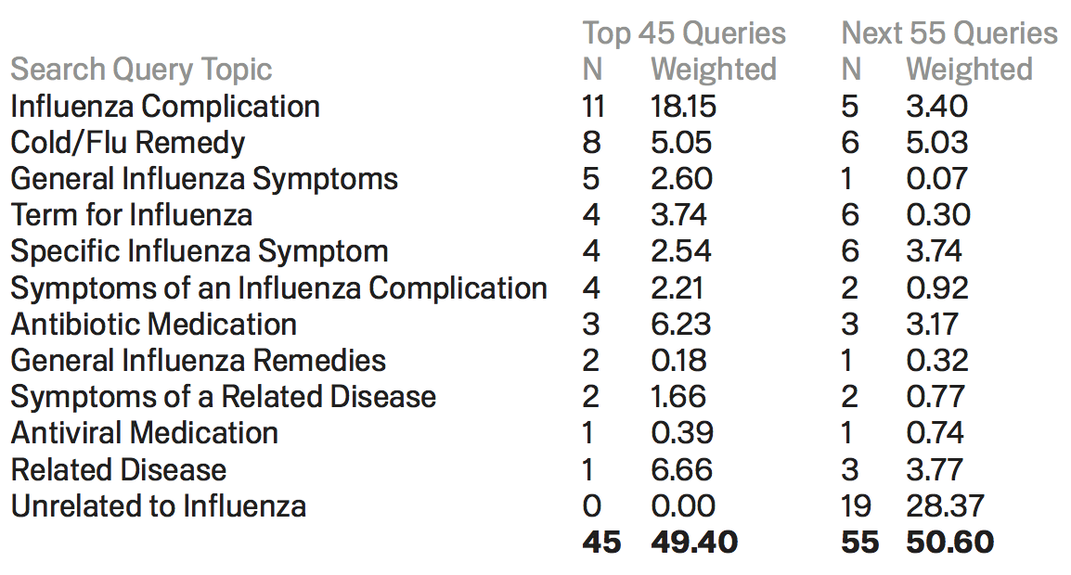
https://research.google.com/archive/papers/detecting-influenza-epidemics.pdf

Slide 32
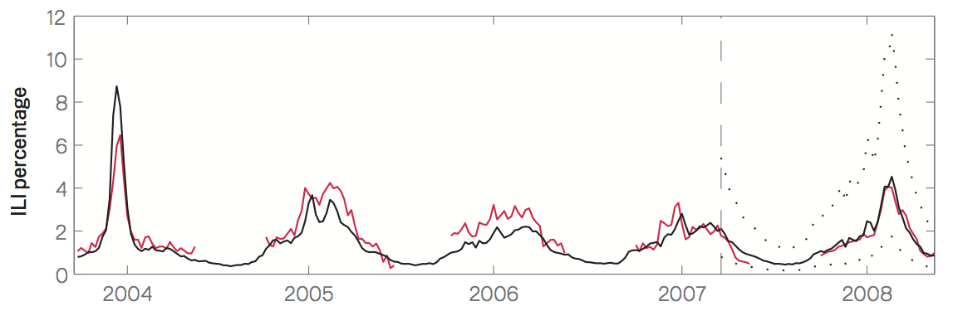
CDC Data
Prediction
https://research.google.com/archive/papers/detecting-influenza-epidemics.pdf

